Slide 1
Struts As a MVC Framework

Slide 2
What Are Struts?
Apache’s open source web application model view controller framework project!
Takes MVC to the next level for web applications.

Slide 3
Struts Collaboration Diagram

Slide 4
ActionServlet
<web-app>
<servlet>
<servlet-name>action</servlet-name>
<servlet-class> org.apache.struts.action.ActionServlet
</servlet-class>
<init-param>
<param-name>debug</param-name>
<param-value>2</param-value>
</init-param>
<init-param>
<param-name>config</param-name>
<param-value>/WEB-INF/struts-config.xml
</param-value>
…
</servlet>
<servlet-mapping>
<servlet-name>action</servlet-name>
<url-pattern>*.do</url-pattern>
</servlet-mapping>
ActionServlet is provided by the framework.
The Servlet must be mapped in the web.xml file.
Must have configuration file mapped
Lastly, Map the *.do URI to the Action Servlet

Slide 5
strut-config.xml
<struts-config>
<!-- ========== Data Source Configuration === -->
<!-- ========== Form Bean Definitions === -->
<form-beans>
<form-bean name="LogonForm"
type="com.codementor.LogonForm"/>
</form-beans>
<!-- ========== Global Forward Definitions === -->
<global-forwards> </global-forwards>
<!-- ========== Action Mapping Definitions === -->
<action-mappings>
<action path="/logon"
type="com.codementor.LogonAction"
name="LogonForm"
scope="request"
input="/logon.jsp">
<forward name="success" path="/sucess.jsp"/>
<forward name="failure" path="/failure.jsp"/>
</action>
</action-mappings>
</struts-config>
XML configuration file
Allows for:
DataSource definition
Logical name definitions for Forms
View mappings
Local
Global

Slide 6
strut-config.xml
<action path="/logon“
type=“com.codementor.LogonAction”
name="LogonForm"
<forward name="failure" path="/failure.jsp" />
<forward name="success" path="/success.jsp" />
</action>
For requests that hit URL=“/logon”
The frame work will invoke execute() on an instance of class com.codementor.LogonAction
Store request parameters in form variable “LogonForm” which is defined in another location in the xml document.
If the logical name returned by perform() is “failure” go to page “/failure.jsp”
If the Logical name returned by perform() is “success” go to “/success.jsp”

Slide 7
Action Bean
import org.apache.struts.action.*;
public class LogonAction extends Action {
public ActionForward execute(
ActionMapping mapping,
ActionForm form,
HttpServletRequest request,
HttpServletResponse response)
throws IOException, ServletException
{
LogonForm theForm = (LogonForm)form;
String forward="failure";
if(theForm.getUserName().equals("borcon"))
{
forward="success";
}
return mapping.findForward(forward);
}
}
Action class’s perform is invoked by Action Servlet

Slide 8
Action Form
import org.apache.struts.action.ActionForm;
public class LogonForm extends ActionForm {
private String userName;
private String password;
public String getUserName() {
return userName;
}
public void setUserName(String userName) {
this.userName = userName;
}
public void setPassword(String password) {
this.password = password;
}
public String getPassword() {
return password;
}
}
Action Form has properties which map to the HTML page.
Additionally the form can:
Reset
Validate

Slide 9
Strut Powered JSP
<html:html locale="true">
<head>
<title>Logon Form</title>
<html:base/>
</head>
<body bgcolor="white">
<html:errors/>
<html:form action="logon" focus="userName">
User Name: <html:text property="userName" size="16" maxlength="16"/>
password: <html:password property="password" size="16" maxlength="16"
<html:submit property="submit" value="Submit"/>
<html:reset/>
</html:form>
</body>
</html:html>

Slide 10
Struts Installation
Downlad the zip
http://mirror-fpt-telecom.fpt.net/apache//struts/binaries/struts-1.3.10-all.zip
Unzip and go!
There isn’t an “install”, however there are several files you’ll need.
Readme.txt has details
Main Files of interest
*.jar , especially struts.jar
*.tld
struts-blank.war

Slide 11
Steps to Building
Step 1: Build your JSP in HTML format
It’s back to editing code
Step 2: Convert to Struts format
Step 3: Write the matching ActionForm
public class LogonForm extends ActionForm {}
Step 4: Write the Action class
public class LogonAction extends Action {}

Slide 12
Creating Your First Struts Application Steps to Building
Step 5: Register the entries in struts-config.xml
<action path="/logon"
type="com.codementor.struts.LogonAction"
name="logonForm"
input="/Logon.jsp" >
<forward name="success" path="/Success.jsp" />
<forward name="failure" path="/Failure.jsp" />
</action>
Step 6: Configure web.xml with the ActionServlet

Slide 13
Creating Your First Struts Application JSP Pages
Three Pages
Login Page
Success Page
Failure Page

Slide 14
Creating Your First Struts Application Logon Page – HTML Version
<html>
<head>
<title>Login Form</title>
</head>
<body bgcolor="#ffffff">
<form action="logon.do">
User Name: <input type="text" name="userName" size="16" maxlength="16"/><br />
Password: <input type="text" name="password" size="16" maxlength="16"/><br />
<input type="submit" name="Submit" value="Submit">

Slide 15
Creating Your First Struts Application Logon Page – Struts
<%@ taglib uri="/WEB-INF/struts-html.tld" prefix="html" %>
<html:html>
<head>
<title>Login Form</title>
</head>
<body bgcolor="#ffffff">
<html:form action="logon.do" focus="userName">
<br>
User Name: <html:text maxlength="16" property="userName" size="16"/><br />
Password: <html:text maxlength="16" property="password" size="16"/><br />
<html:submit value="Submit" property="Submit"/>
Added a cool feature

Slide 16
Creating Your First Struts Application Success and Failure Pages
Success.jsp
<html>
<head>
<title>
Success
</title>
</head>
<body bgcolor="#ffffff">
<h1>
Successful Login
</h1>
</body>
</html>
Failure.jsp
<html>
<head>
<title>
Failure
</title>
</head>
<body bgcolor="#ffffff">
<h1>
Failed Login
</h1>
</body>
</html>

Slide 17
Creating Your First Struts Application Create Form Bean Class
package com.codementor;
import org.apache.struts.action.ActionForm;
public class LogonForm extends ActionForm {
private String password;
private String userName;
public String getPassword() {
return password;
}
public void setPassword(String password) {
this.password = password;
}
public String getUserName() {
return userName;
}
public void setUserName(String userName) {
this.userName = userName;
}
}

Slide 18
Creating Your First Struts Application Form Bean Config
<struts-config>
<form-beans>
<form-bean name="logonForm"
type="com.codementor.LogonForm" />
</form-beans>
…
</struts-config>

Slide 19
Creating Your First Struts Application Action Class
package com.codementor;
import org.apache.struts.action.*;
import javax.servlet.http.*;
public class LogonAction extends Action {
public ActionForward execute(ActionMapping mapping,
ActionForm form,
HttpServletRequest request,
HttpServletResponse response) {
LogonForm logonForm = (LogonForm) form;
String forward = "failure";
if(logonForm.getUserName().equals("mentor"))
{
forward = "success";
}
return mapping.findForward(forward);
}
}

Slide 20
Creating Your First Struts Application Action Class Config
…
<action-mappings>
<action path="/logon"
type="com.codementor.LogonAction"
name="logonForm"
input="/Login.jsp"
scope="request" />
</action-mappings>
</struts-config>

Slide 21
Creating Your First Struts Application Map The Forwards
…
<action-mappings>
<action path="/logon"
type="com.codementor.LogonAction"
name="logonForm"
input="/Login.jsp"
scope="request" >
<forward name="success" path="/Success.jsp" />
<forward name="failure" path="/Failure.jsp" />
</action>
</action-mappings>
</struts-config>

Slide 22
Creating Your First Struts Application Struts in web.xml
<web-app>
<servlet>
<servlet-name>action</servlet-name>
<servlet-class>org.apache.struts.action.ActionServlet</servlet-class>
<init-param>
<param-name>config</param-name>
<param-value>/WEB-INF/struts-config.xml</param-value>
</init-param>
<init-param>
<param-name>debug</param-name>
<param-value>2</param-value>
</init-param>
<load-on-startup>2</load-on-startup>
</servlet>
Sets the logging level for struts
Loads ActionServlet on startup
** important if there is a JSP page
which could be referenced from the
Client **

Slide 23
Creating Your First Struts Application Web.xml URI Mapping
<servlet-mapping>
<servlet-name>action</servlet-name>
<url-pattern>*.do</url-pattern>
</servlet-mapping>

Slide 24
Creating Your First Struts Application Configure Tags
…
<taglib>
<taglib-uri>/WEB-INF/struts-bean.tld</taglib-uri>
<taglib-location>/WEB-INF/struts-bean.tld</taglib-location>
</taglib>
<taglib>
<taglib-uri>/WEB-INF/struts-html.tld</taglib-uri>
<taglib-location>/WEB-INF/struts-html.tld</taglib-location>
</taglib>
</web-app>

Slide 25
Creating Your First Struts Application Configure WebApp
/sample
Logon.jsp
Success.jsp
Failure.jsp
/WEB-INF
web.xml
struts-config.xml
*.tld – all the struts tld files
/lib
*.jars - all the struts jars
/classes
LogonAction
LogonForm

Slide 26
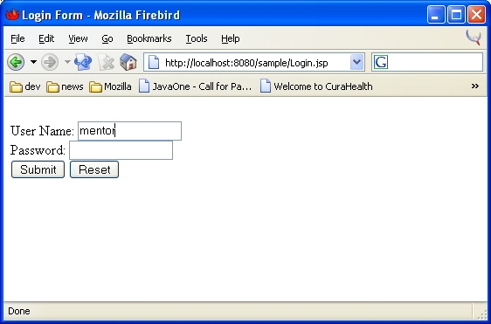
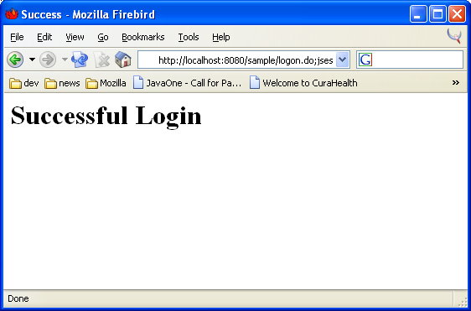
Creating Your First Struts Application Run The WebApp

Slide 27
Questions?

